Slide 1

HDR – UK Summer School Discussion Meetings Introduction to Spatial Data Sources and Web Mapping
Alexandros Alexiou
Research Associate
Department of Public Health and Policy
Institute of Population Health Sciences
University of Liverpool
a.alexiou@liverpool.ac.uk

Slide 2
Topics
Spatial Data Sources in the UK
Where to find data
What kind of data is there
Is it accessible?
Web-mapping
Popular platforms
Programming (i.e. R)
Practical
Introduction to Web-mapping in R
https://rpubs.com/dblalex/520888
Discussion

Slide 3
(Open) Spatial Data Sources in the UK
Ordnance Survey
The national mapping agency for Great Britain
OpenStreetMap.org
Crowdsourced, free “Google Maps”
Open Geography Portal (ONS)
UK Data Service
Digimap – Edina (University of Edinburgh)
Consumer Data Research Centre (CDRC)
Other Government data (for linkage)
ONS, NRS etc
Local Authorities
NHS Digital
Sector data, e.g. Defra, HM Land Registry, MHCL, Ofcom, Historic England, etc.

Slide 4

Ordnance Survey
Many products
Some are free to use
OS Open Map Local
Some are paid for
but may be supplied free for academic use (e.g. OS MasteMap)

Slide 5
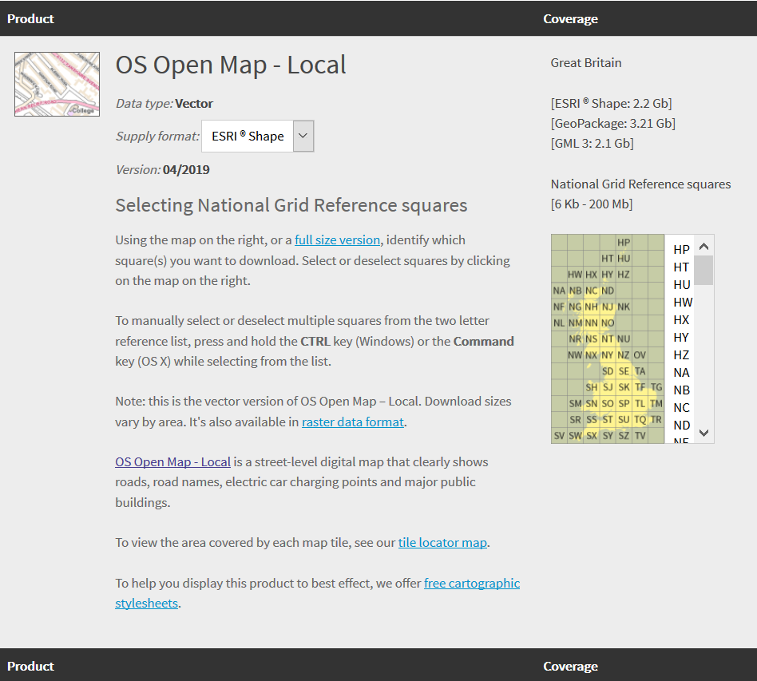
Ordnance Survey
Link to open products:
https://www.ordnancesurvey.co.uk/opendatadownload/products.html

Slide 6
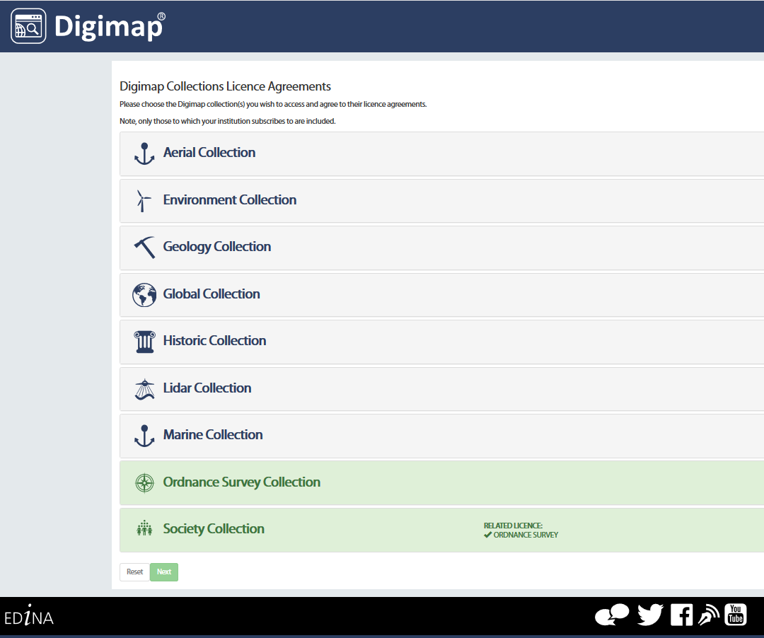
Digimap
Variety of spatial data available for download with registering through academic/educational institution.
https://digimap.edina.ac.uk/

Slide 7
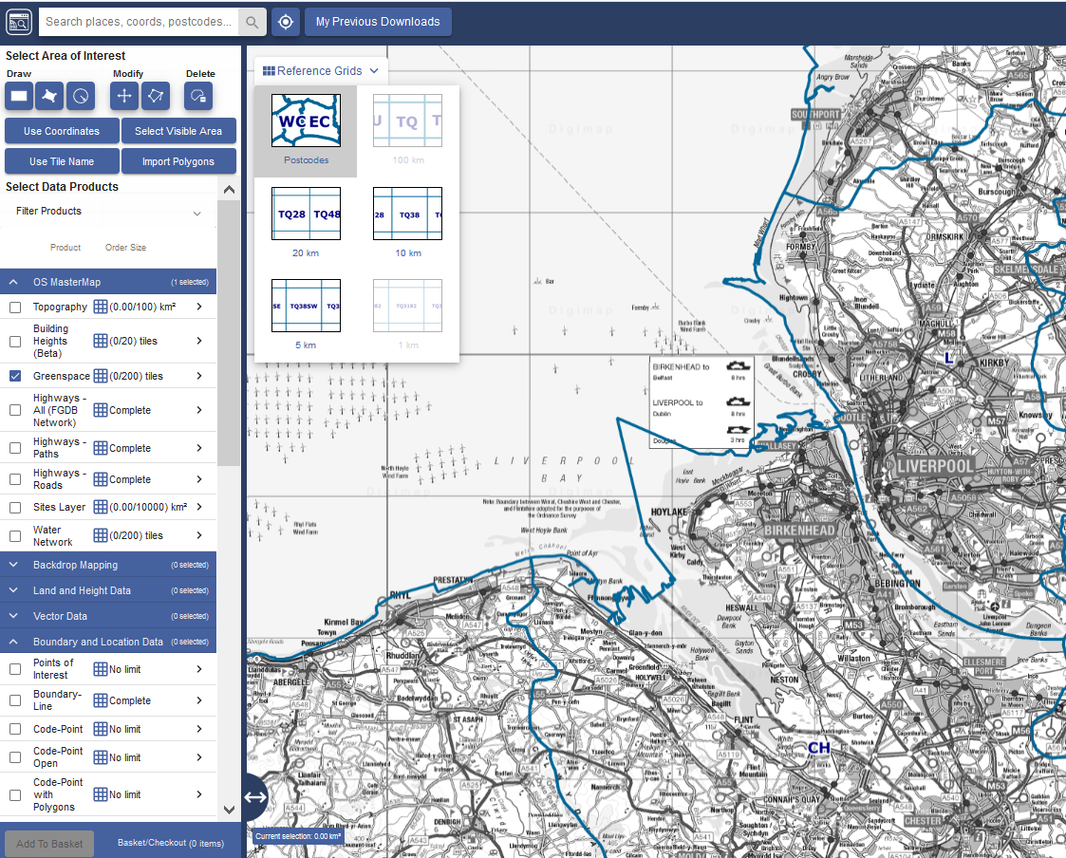
Digimap
Variety of spatial data available for download with registering through academic/educational institution.
https://digimap.edina.ac.uk/

Slide 8
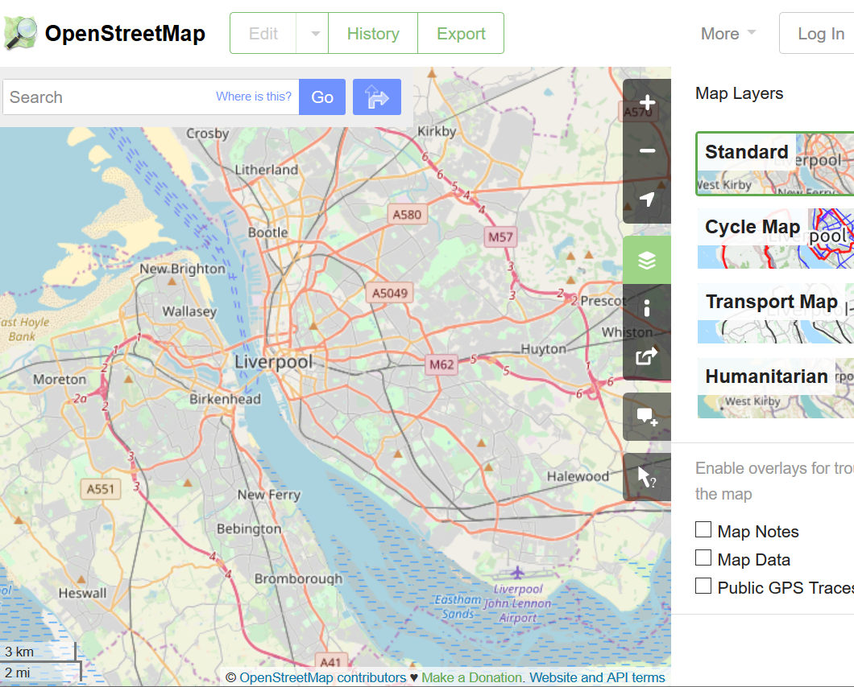
OpenStreetMap
Free to download globally
Bulk downloads
Tags helps identify features
Accuracy is uncertain
https://www.openstreetmap.org/

Slide 9
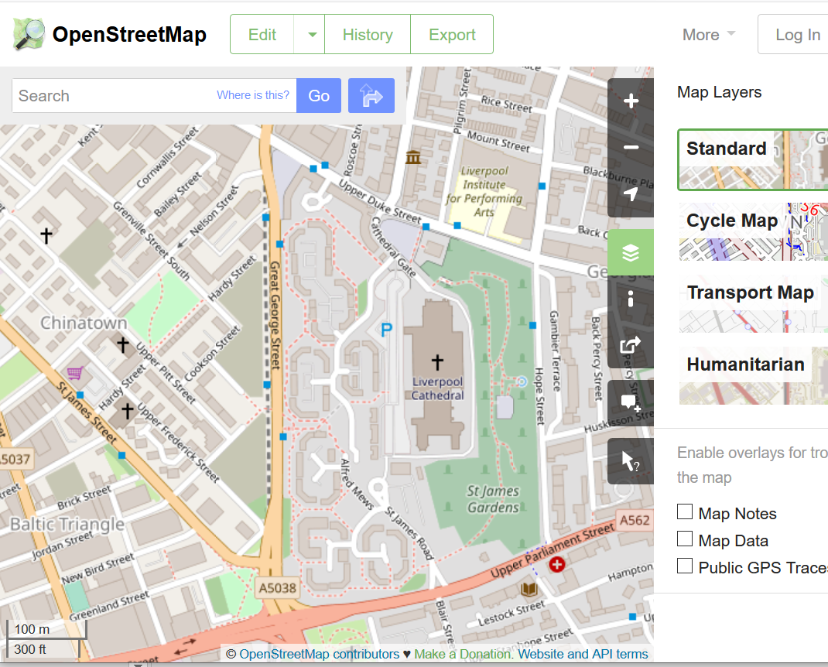
OpenStreetMap
Free to download globally
Bulk downloads
Tags helps identify features
Accuracy is uncertain
https://www.openstreetmap.org/

Slide 10
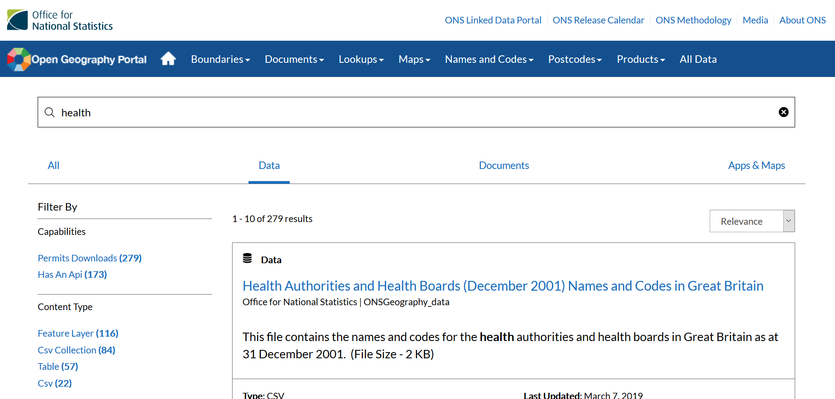
Open Geography Portal
ONS official geography-related data platform
Spatial data, boundaries, look-up tables and more
Explore data on the spot
Offers many data formats, including APIs
Links are dynamic
http://geoportal.statistics.gov.uk/

Slide 11
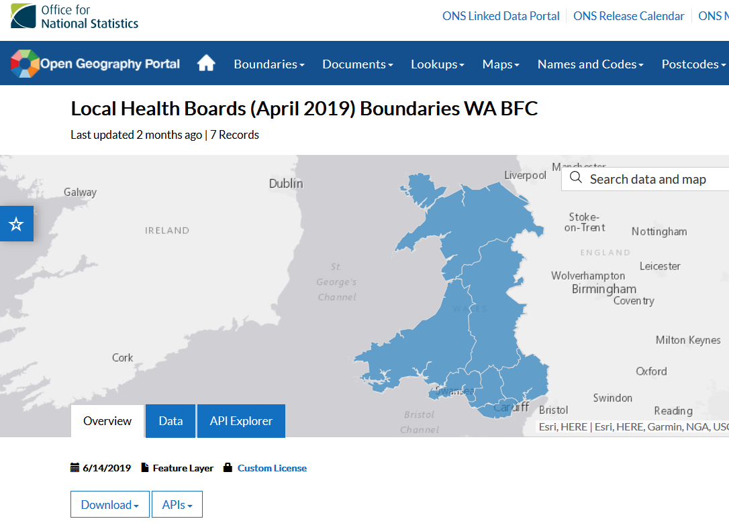
Open Geography Portal
ONS official geography-related data platform
Spatial data, boundaries, look-up tables and more
Explore data on the spot
Offers many data formats, including APIs
Links are dynamic
http://geoportal.statistics.gov.uk/

Slide 12
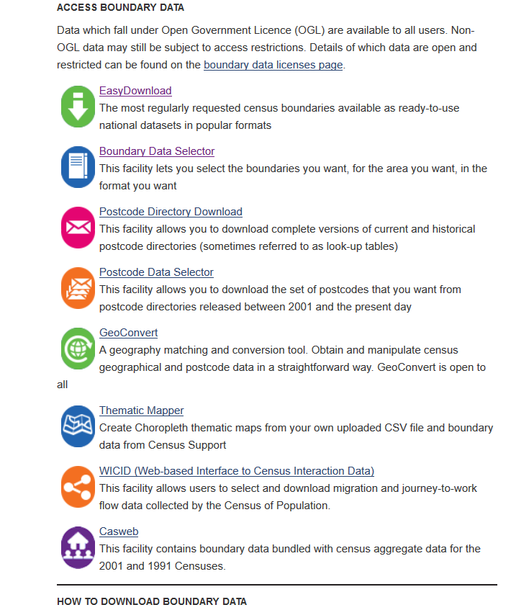
UK Data Service
Census Boundaries, quick and easy
Postcode look-ups
Various other data
https://census.ukdataservice.ac.uk/get-data/boundary-data.aspx

Slide 13
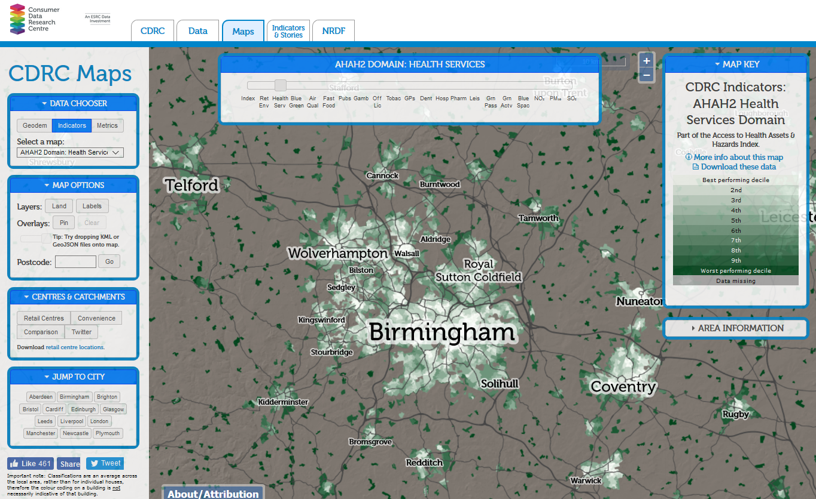
CDRC
Various spatial data
Some are open, but many are secure / safeguarded
Collection of “new” spatial products, like AHAH index
Open data that can be viewed on the spot

Slide 14
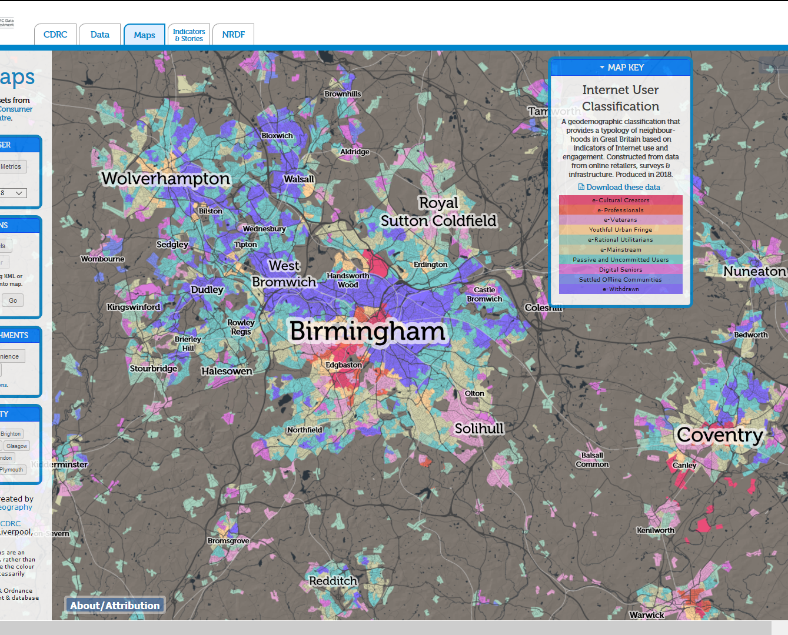
CDRC
Various spatial data
Some are open, but many are secure / safeguarded
Collection of “new” spatial products, like AHAH index
Open data that can be viewed on the spot

Slide 15
Data linkage
Data linkage to other spatial data
Administrative data
NHS digital
Usually postcodes (e.g. GPs, A&E etc)
Census Geography
NHS Geography
Other Authorities, organizations etc.

Slide 17
Data linkage
Data linkage to other spatial data:
Administrative data
NHS digital
Usually postcodes (e.g. GPs, A&E etc)
Census Geography
NHS Geography
Other Authorities, organizations etc.

Slide 18
NSPL & ONSPD
National Statistics Postcode Lookup (NSPL)
Use the NSPL for producing statistics.
http://geoportal.statistics.gov.uk/search?q=National%20Statistics%20Postcode%20Lookup
ONS Postcode Directory
Use the ONSPD for more exact allocation of postcodes, for example for operational or administrative applications, but not for statistical applications.
Use NSPL:
UK coverage
Updated every 3 months
Links to higher geography
Links to other variables such as :

Slide 19
NSPL & ONSPD
pcd : chr "AB1 0AA" "AB1 0AB" "AB1 0AD" "AB1 0AE" ...
pcd2 : chr "AB1 0AA" "AB1 0AB" "AB1 0AD" "AB1 0AE" ...
pcds : chr "AB1 0AA" "AB1 0AB" "AB1 0AD" "AB1 0AE" ...
dointr : int 198001 198001 198001 199402 199012 199012 198001 198001 198001 198001 ...
doterm : int 199606 199606 199606 199606 199207 199207 199606 199606 199606 199606 ...
usertype: int 0 0 0 0 1 1 0 0 1 0 ...
oseast1m: int 385386 385177 385053 384600 384460 383890 384779 384669 385225 385208 ...
osnrth1m: int 801193 801314 801092 799300 800660 800710 800921 801228 800757 800834 ...
osgrdind: int 1 1 1 8 8 8 1 1 1 1 ...
oa11 : chr "S00090303" "S00090303" "S00090399" "S00091322" ...
cty : chr "S99999999" "S99999999" "S99999999" "S99999999" ...
laua : chr "S12000033" "S12000033" "S12000033" "S12000034" ...
ward : chr "S13002484" "S13002484" "S13002484" "S13002505" ...
hlthau : chr "S08000020" "S08000020" "S08000020" "S08000020" ...
hro : chr "S99999999" "S99999999" "S99999999" "S99999999" ...
ctry : chr "S92000003" "S92000003" "S92000003" "S92000003" ...
gor : chr "S99999999" "S99999999" "S99999999" "S99999999" ...
pcon : chr "S14000002" "S14000002" "S14000002" "S14000058" ...
eer : chr "S15000001" "S15000001" "S15000001" "S15000001" ...
teclec : chr "S09000001" "S09000001" "S09000001" "S09000001" ...
ttwa : chr "S22000047" "S22000047" "S22000047" "S22000047" ...
pct : chr "S03000012" "S03000012" "S03000012" "S03000013" ...
nuts : chr "S31000935" "S31000935" "S31000934" "S31001005" ...
park : chr "S99999999" "S99999999" "S99999999" "S99999999" ...
lsoa11 : chr "S01006514" "S01006514" "S01006514" "S01006853" ...
msoa11 : chr "S02001237" "S02001237" "S02001237" "S02001296" ...
wz11 : chr "S34002990" "S34002990" "S34003015" "S34003292" ...
ccg : chr "S03000012" "S03000012" "S03000012" "S03000013" ...
bua11 : chr "S99999999" "S99999999" "S99999999" "S99999999" ...
buasd11 : chr "S99999999" "S99999999" "S99999999" "S99999999" ...
ru11ind : chr "3" "3" "3" "6" ...
oac11 : chr "1C3" "1C3" "6A1" "1A2" ...
lat : num 57.1 57.1 57.1 57.1 57.1 ...
long : num -2.24 -2.25 -2.25 -2.26 -2.26 ...
lep1 : chr "S99999999" "S99999999" "S99999999" "S99999999" ...
lep2 : chr "S99999999" "S99999999" "S99999999" "S99999999" ...
pfa : chr "S23000009" "S23000009" "S23000009" "S23000009" ...
imd : int 6808 6808 6808 5503 6668 5272 6808 6668 6808 6808 ...

Slide 20
Data linkage
Many other authorities have “spatial” data such as:
Defra: Air pollution data
Food Standards Agency: UK food hygiene rating data
Data Police UK: Crime data (LSOA level)
HM Land Registry: Every building transaction and price paid data
Ministry of Housing, Communities & Local Government: EPC data
Historic England: Data on parks and historic buildings
Department for Transport: National Public Transport Access Nodes (NaPTAN)
etc.

Slide 21
Part II: Web-mapping
Several platforms, most popular are:
CARTO (previously CartoDB)
ArcGIS Online
Programming (e.g. R, Python, JavaScript etc)

Slide 22


Slide 23
Carto
- Not free (any more)
+ Can get an Educator Account
Educator Accounts. Educators are also eligible for a free CARTO account. Simply create a trial CARTO Account, then request an Educator account by emailing partners@carto.com. We welcome educators from accredited institutions as well as bootcamps and similar training organizations.
+ Easy to use GUI
+ Can edit with CSS increasing functionality
Example maps:
https://dblalex.carto.com/builder/4beddbf7-bcee-454a-a941-00d3120dc779/embed
https://dblalex.carto.com/builder/7a8651b3-f407-4aa4-85a7-205d05565ec1/embed

Slide 24
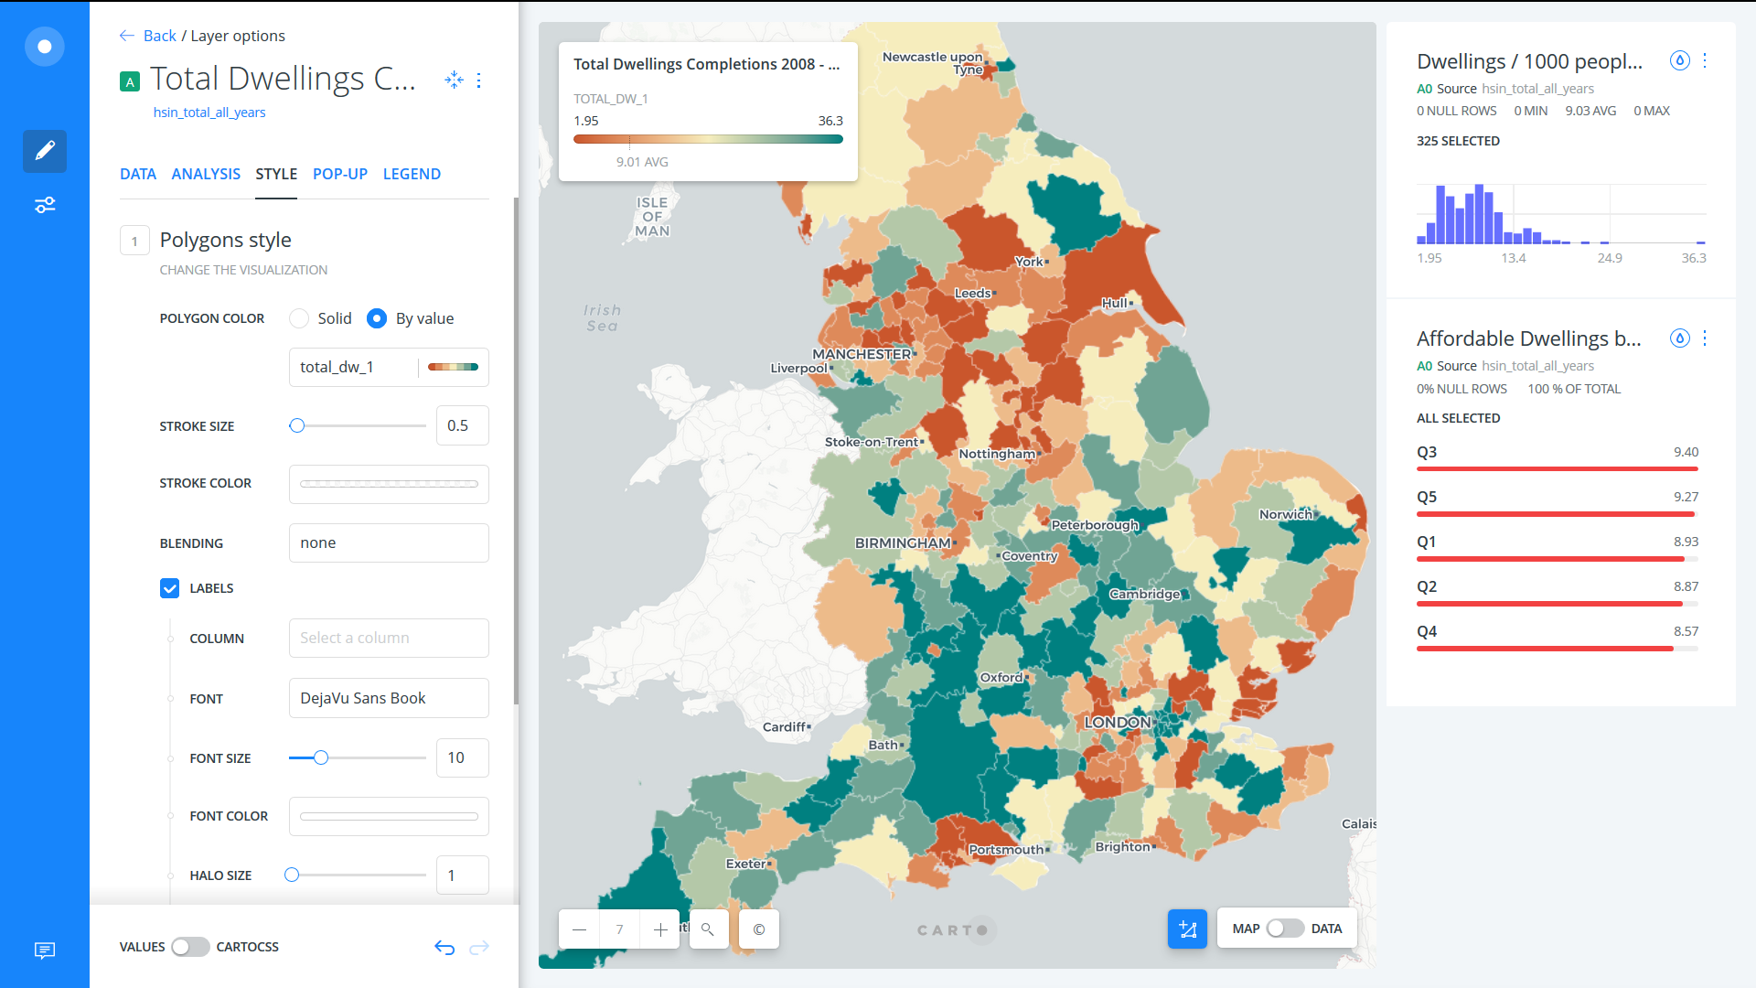

Slide 25
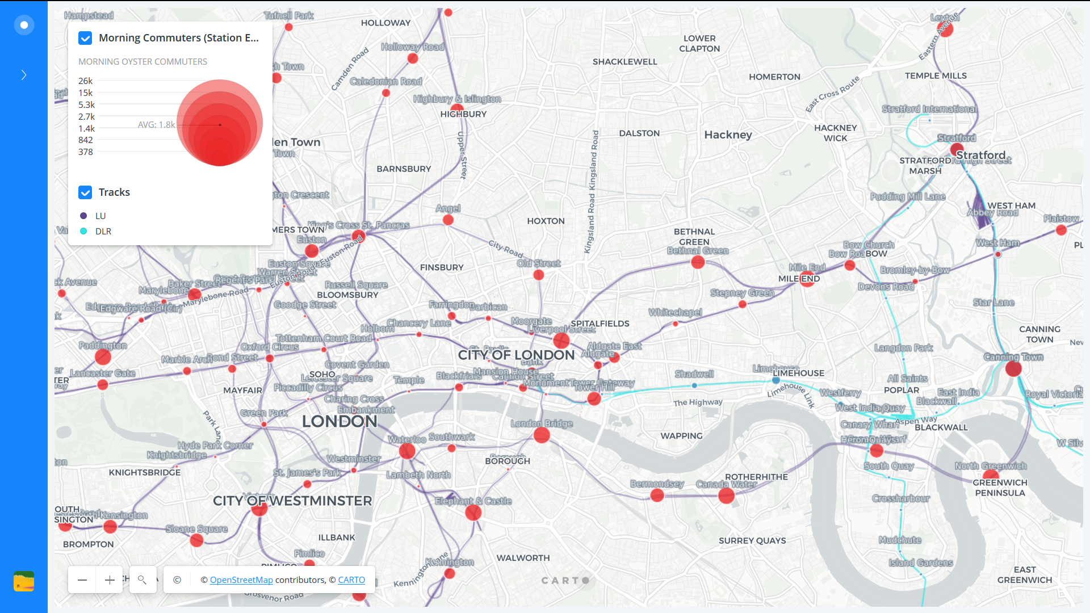

Slide 26
ArcGIS Online
+ Free
+ Easy to use
Limited functionality
Not exactly a webmap; can’t embed – but can share the map page
+ Can make “Map Journals”, i.e. online presentation with maps and other media.
Web Map Example: https://arcg.is/viabr
Map Journal Example: https://arcg.is/1v4eri

Slide 27
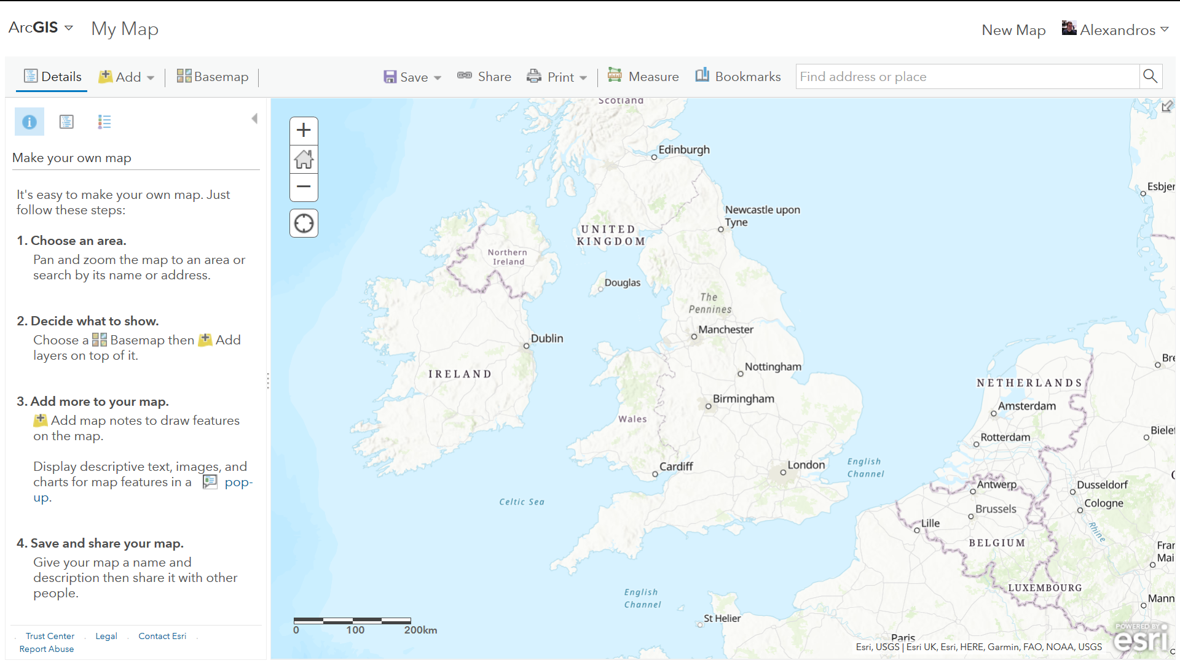

Slide 28
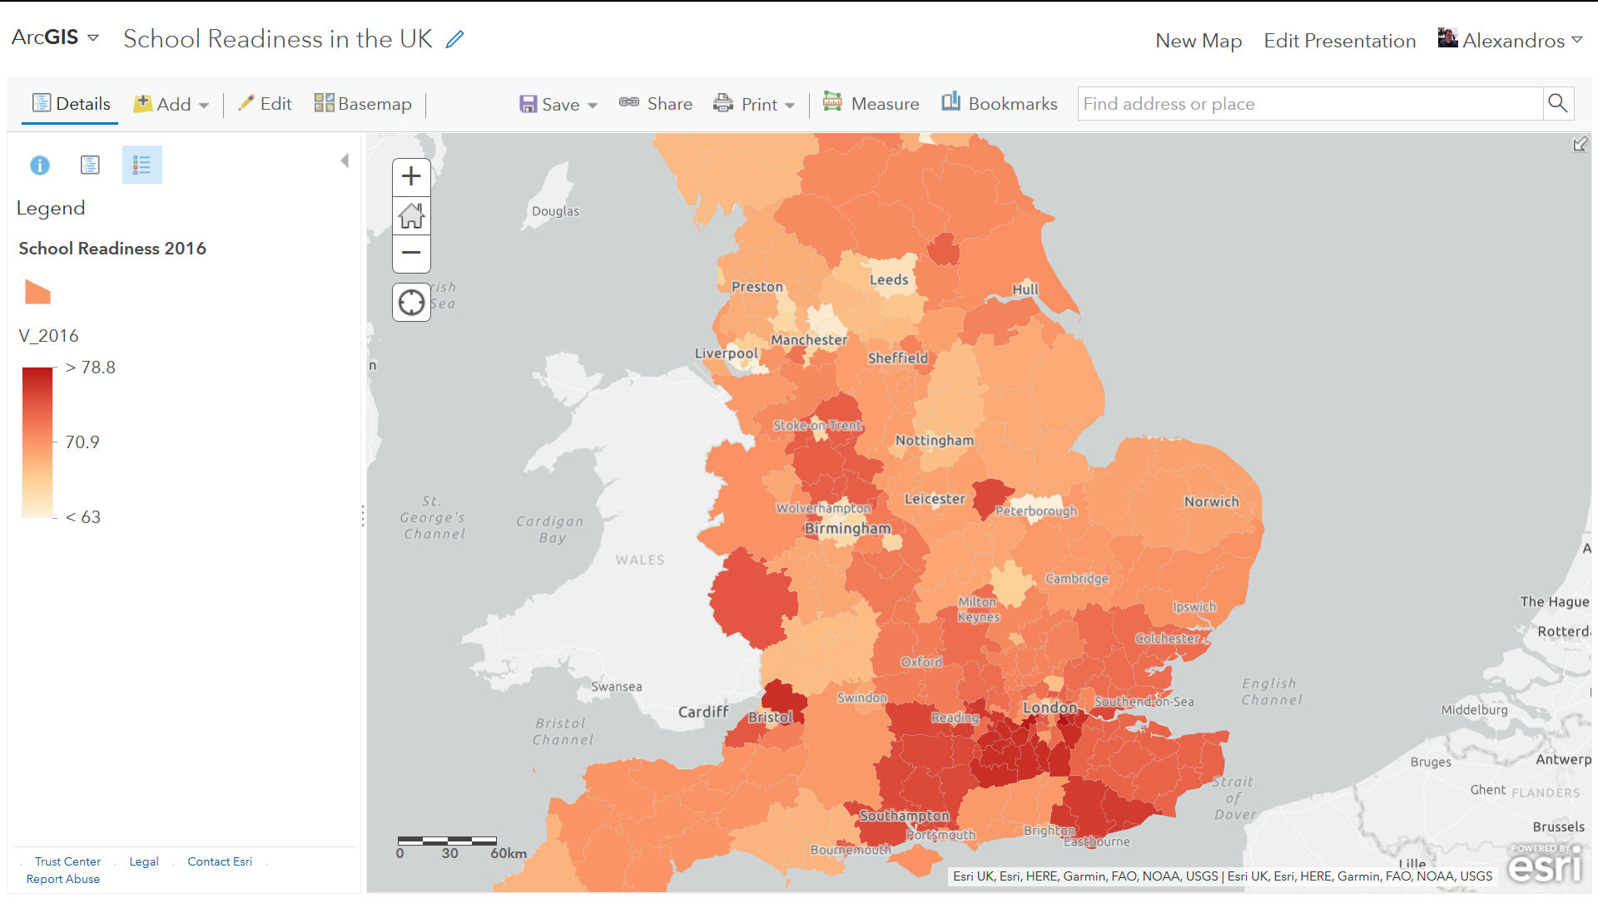

Slide 29
Programming
Leaflet is one of the most popular open-source JavaScript libraries for interactive maps.
R has a leaflet library; needs however to run through a server or through GitHub with https://pages.github.com.
Practical:
RPubs: https://rpubs.com/dblalex/521112
GitHub Rmd file: https://github.com/alalexiou/HDR-UK_Webmapping_in_R/blob/master/HDRUK_Practical_Webmapping.Rmd

Slide 30
Discussion
Thanks for your time!
Presentation File:

